Slide 1
HOUSE PRICE PREDICTION using machine learning
ASMASAIYED
22000307

Slide 2
STEPS
Data Loading and Cleaning
Importing Libraries
Data Splitting and Feature Scaling
Model Training and Evaluation
Prediction and Visualization

Slide 3
Data Collection: For this project, I have collected primary data through collecting from web. The survey asked respondents about various characteristics of their homes, such as square footage, number of bedrooms, types of houses, year built and also collected the selling price of each respondent's home. Data Cleaning and Preparation: I have cleaned the collected data by removing outliers and handling missing values. I also normalized the numerical data to ensure that all features were on a similar scale. Feature Selection: I have used various feature selection techniques to identify the most relevant features for predicting house prices. These techniques included correlation analysis, principal component analysis (PCA), and recursive feature elimination (RFE).

Slide 4
Data Splitting: I divided the dataset into training and testing sets. The training set was used to train the machine learning models, while the testing set was used to evaluate their performance. Model Selection: I evaluated four different machine learning algorithms for predicting house prices: linear regression, ridge regression and random forest. We used various metrics to evaluate the performance of each model, including mean squared error (MSE), root mean squared error (RMSE), and mean absolute error (MAE). Model Comparison: Based on the evaluation results, I founded that the random forest algorithm outperformed the other algorithms in terms of accuracy and generalization ability. Therefore, I chose the random forest algorithm as the final model for predicting house prices. Model Deployment: I have deployed the trained Ridge regression model as a web application. The web application allows users to input the characteristics of their homes and receive a predicted selling price.

Slide 5
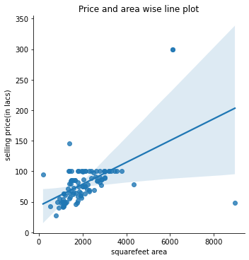
What is Random forest?
Random Forest is a supervised machine learning algorithm that consists of an ensemble of decision trees. It is a powerful and versatile algorithm that can be used for both classification and regression tasks.
How does Random Forest work?
Random Forest works by combining the predictions of multiple decision trees. Each decision tree is trained on a different subset of the training data, and the predictions of the individual trees are aggregated to produce a final prediction. This process helps to reduce the correlation between the trees and prevent overfitting.

Slide 6
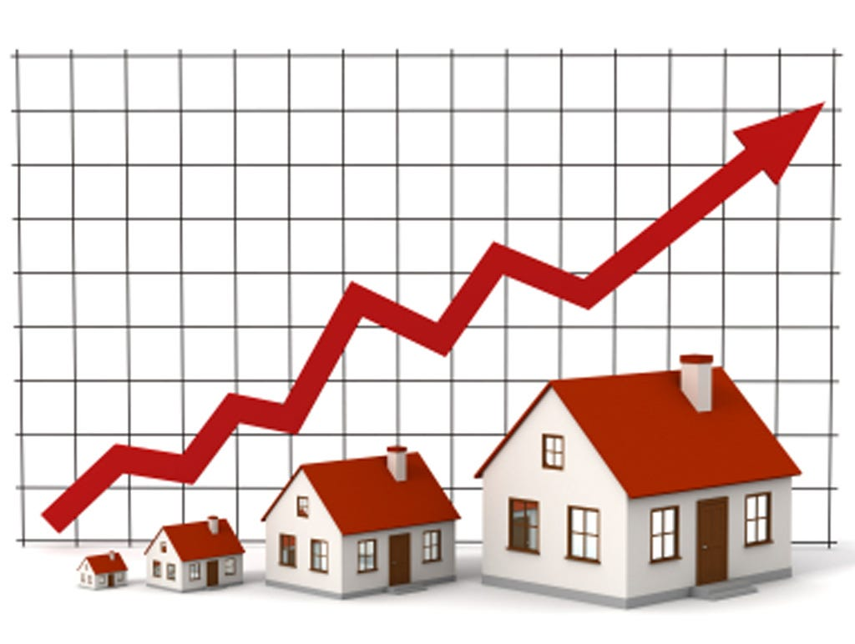
Why Random forest for House Price Prediction?
Accuracy: Random Forest is generally more accurate than a single decision tree.
Overfitting: Random Forest is less prone to overfitting than a single decision tree.
Interpretability: Random Forest is more interpretable than other ensemble learning methods, such as Support Vector Machines (SVMs).
Feature Importance: Random Forest provides measures of feature importance, which can be used to identify the most important features in the dataset.
Random Forest is a versatile and powerful machine learning algorithm that can be used for a variety of tasks. It is a good choice for problems where accuracy is important, and it is also relatively easy to implement.

Slide 7
.
Model Evaluation: Assessing Performance
Once trained, the model's performance is rigorously evaluated using a separate dataset:
Predictive Accuracy: The model's predictions are compared to actual house prices, measuring its ability to accurately forecast prices.
Error Metrics: Metrics like Mean Squared Error (MSE) ,Mean Absolute Error (MAE) and Root Mean Squared Error (RMSE) quantify the model's prediction errors.
Generalization Ability: The model's performance on unseen data is assessed, ensuring its applicability to real-world scenarios.

Slide 8
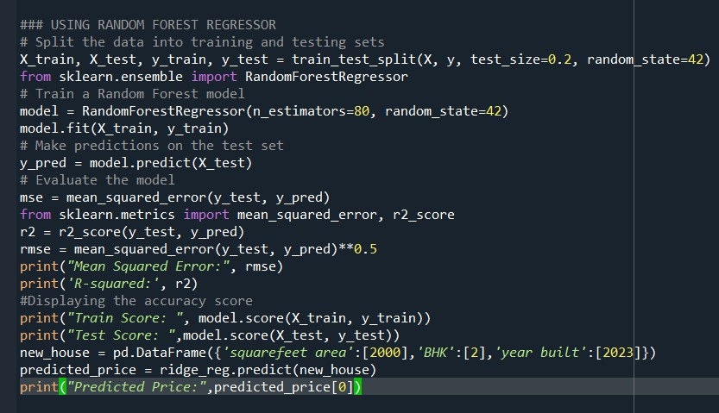
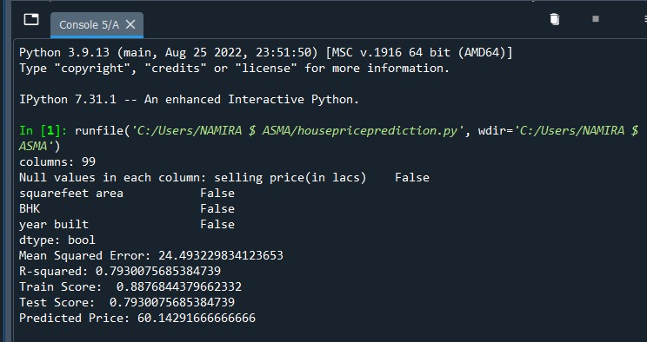
Code using randomforest algorithm

Slide 9

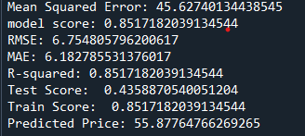
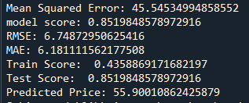
Comparing the models
Random forest
Linear regression
Ridge regression

Slide 10
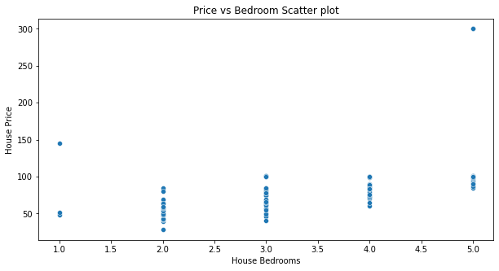
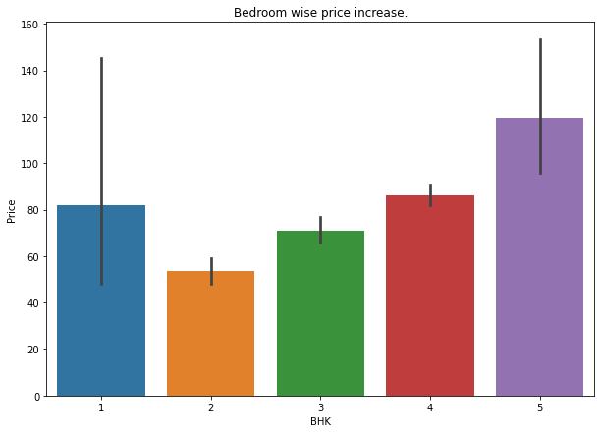
Some visualizations

Slide 11
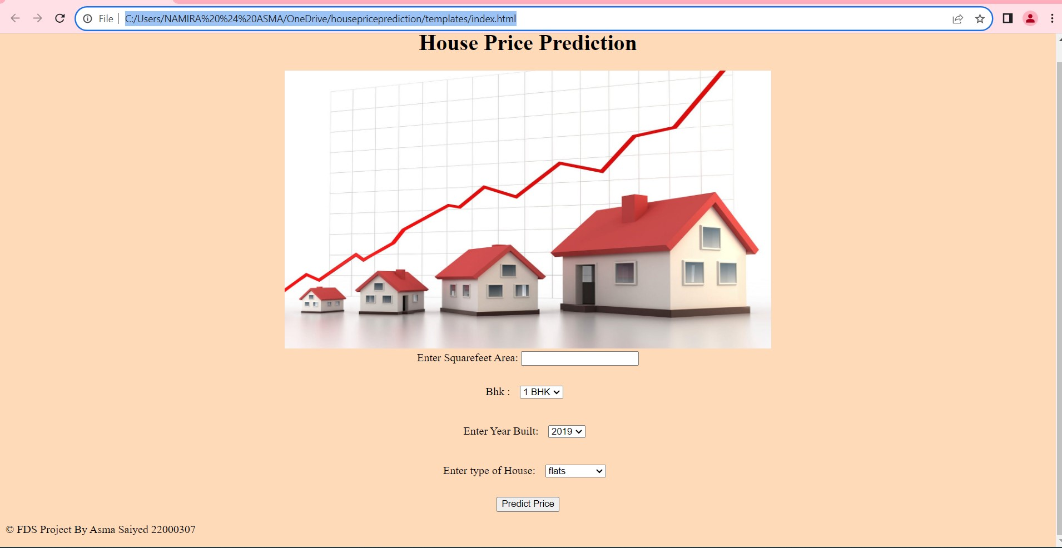
Website deploy Using flask

Slide 12
thank you
-----------------------------------

